Slide 1
Language-specific Features
MATLAB is not just a programming language, it is designed specifically for mathematical computation, engineering analysis, and scientific visualization. Compared to languages like C, C++, or Python, MATLAB has unique features that make it easier and faster for engineers to perform numerical work.
Matrix-Oriented Language
Element-wise Operations
Vectorization
Built-in Plotting & Visualization
Extensive Built-in Functions
Ease of Interfacing

Slide 2
Matrix oriented language
MATLAB stands for Matrix Laboratory.
Every variable in MATLAB is treated as a matrix (array) by default.
Scalars are treated as 1×1 matrices, and vectors are 1×n or n×1 matrices.
This makes it easy to perform linear algebra, numerical analysis, and engineering computations directly.
A = [1 2; 3 4];
B = [5 6; 7 8];
C = A * B; % Matrix multiplication
Element-wise Operations
In MATLAB, operations can be performed element by element using special operators (.*, ./, .^).
It is useful when working with arrays where each element must be treated independently.
It prevents the need for writing loops, making the code concise and faster.
x = [1 2 3 4];
y = x.^2; % Element-wise squaring
% Loop version
for i = 1:1000
y(i) = i^2;
end
Vectorization
Vectorization means replacing loops with matrix/vector operations.
MATLAB is optimized for handling vectors and matrices directly, which makes computations much faster.
Instead of writing iterative loops, one can write compact and efficient code.
% Vectorized version
x = 1:1000;
y = x.^2; % Much faster

Slide 3
Built-in Plotting & Visualization
MATLAB provides powerful 2D and 3D plotting functions built-in.
Engineers and scientists can visualize data immediately without external libraries.
Functions include plot, plot3, mesh, surf, bar, histogram, etc.
x = 0:0.1:10;
y = x.^2 - 5*x + 6;
plot(x,y,'k-','LineWidth',1.5);
xlabel('x'); ylabel('y');
title('Quadratic Function');
Extensive Built-in Functions
MATLAB has thousands of pre-defined functions for mathematics, signal processing, image processing, optimization, control systems, etc.
Users rarely need to code standard algorithms from scratch.
Functions like inv, eig, fft, polyfit, ode45, etc., are directly available
A = [2 1; 7 4];
d = det(A); % Determinant
[V,D] = eig(A); % Eigenvalues & Eigenvectors
Ease of Interfacing
MATLAB can interface easily with other software and languages. It can call C/C++ functions, Fortran codes, and Python functions.
Supports exporting results to Excel, text files, images, and reports.
Provides Simulink for graphical system modeling.
A = rand(5,5);
writematrix(A,'output.xlsx');

Slide 4
Feature | Meaning | Example in MATLAB
Matrix-Oriented | Everything is treated as a matrix | C = A*B
Element-wise Operations | Perform operation element by element | z = x .* y
Vectorization | Replace loops with array operations | y = x.^2
Built-in Plotting | Easy 2D/3D plotting | plot(x,y)
Built-in Functions | Predefined math/engineering functions | det(A), eig(A)
Ease of Interfacing | Connect with Excel, Python, etc. | writematrix(A,'file.xlsx')

Slide 5
Loops, branches, and control-flow
MATLAB has its own syntax for control-flow statements such as for loops, while loops and, of course, if-elseif-else branching. In addition, it provides three commands break, error, and return to control the execution of scripts and functions.
For loops
A for loop is used to repeat a statement or a group of statements for a fixed number of times.
Example: Sum of the first 5 natural numbers
sum = 0;
for i = 1:5
sum = sum + i;
end
disp(['Sum = ', num2str(sum)]);

Slide 6
While loops
A while loop is used to execute a statement or a group of statements for an indefinite number of times until the condition specified by while is no longer satisfied.
Example: Adding natural numbers starting from 1 until the sum becomes greater than or equal to 20. At each step, display the value of i and the current sum.
sum = 0; i = 1;
while sum < 20
sum = sum + i;
disp(['i = ', num2str(i), ', Sum = ', num2str(sum)]);
i = i + 1;
end

Slide 7
If-elseif-else statements
This construction provides a logical branching for computations.
Example: Write a MATLAB program that takes the stress value (in MPa) as input and classifies it as:
Safe if stress < 100 Mpa
Warning if 100 ≤ stress < 200 Mpa
Danger if stress ≥ 200 Mpa
Display an appropriate message based on the input stress value.
stress = input('Enter stress value (MPa): ');
if stress < 100
disp('Safe stress level');
elseif stress >= 100 && stress < 200
disp('Warning: Approaching limit');
else
disp('Danger: Stress exceeds safe limit!');
end

Slide 8
Break
The command break inside a for or while loop terminates the execution of the loop, even if the condition for execution of the loop is true.
Example: A material is tested under different stress values given in the vector: stress_values=[80, 95, 120, 160, 180].
Write a MATLAB program using a for loop to display each stress value. If the stress exceeds 150 MPa, display a warning message “Stress exceeded limit! Breaking loop.” and stop further execution of the loop.
stress_values = [80 95 120 160 180];
for i = 1:length(stress_values)
if stress_values(i) > 150
disp('Stress exceeded limit! Breaking loop.');
break;
end
disp(['Stress = ', num2str(stress_values(i))]);
end

Slide 9
Error
The command error ( 'message') inside a function or a script aborts the execution, displays the error message, and returns control to the keyboard.
Example: Write a MATLAB program that takes an input denominator from the user and divides 10 by this value.
If the denominator is 0, display an error message: "Division by zero is not allowed.“
Otherwise, calculate and display the result.
x = input('Enter denominator: ');
if x == 0
error('Division by zero is not allowed.');
else
y = 10/x;
disp(['Result = ', num2str(y)]);
end

Slide 10
Return
Exits from a function immediately without executing the remaining code.
Example: Write a MATLAB function that calculates the volume of a cylinder. If radius or height is negative, use return to exit early without calculation.
function V = cyl_volume(r, h)
if r < 0 || h < 0
disp('Negative radius/height not allowed. Exiting.');
V = NaN;
return
end
V = pi * r^2 * h;
end

Slide 11
Examples
Q1. Write a MATLAB script to calculate the factorial of a given number using a for loop.
Q2. Write a MATLAB script to display all numbers from 1 to 20 using a while loop.
n = input('Enter a number: ');
fact = 1;
for i = 1:n
fact = fact * i;
end
disp(['Factorial of ', num2str(n), ' is ', num2str(fact)]);
i = 1;
while i <= 20
disp(i);
i = i + 1;
end

Slide 12
Q3. Write a MATLAB program that checks whether a number is positive, negative, or zero using if-elseif.
Q4. Write a MATLAB program using while loop to compute the sum of digits of a number.
n = input('Enter a number: ');
if n > 0
disp('Positive Number');
elseif n < 0
disp('Negative Number');
else
disp('Zero');
end
n = input('Enter a number: ');
sum_digits = 0;
while n > 0
d = mod(n,10);
sum_digits = sum_digits + d;
n = floor(n/10);
end
disp(['Sum of digits = ', num2str(sum_digits)]);

Slide 13
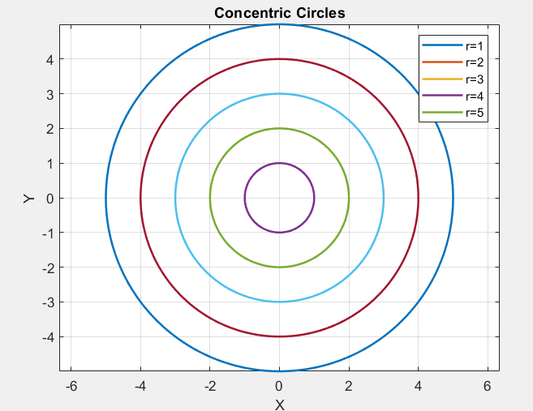
Example:
Plot a Concentric Circle of radius (1,2,3,4,5)
theta = linspace(0,2*pi,200);
for r = [1 2 3 4 5]
x = r*cos(theta);
y = r*sin(theta);
plot(x,y,'LineWidth',1.5); hold on;
end
axis equal;
grid on;
title('Concentric Circles');
legend('r=1','r=2','r=3','r=4','r=5');
xlabel('X');
ylabel('Y');

Slide 14
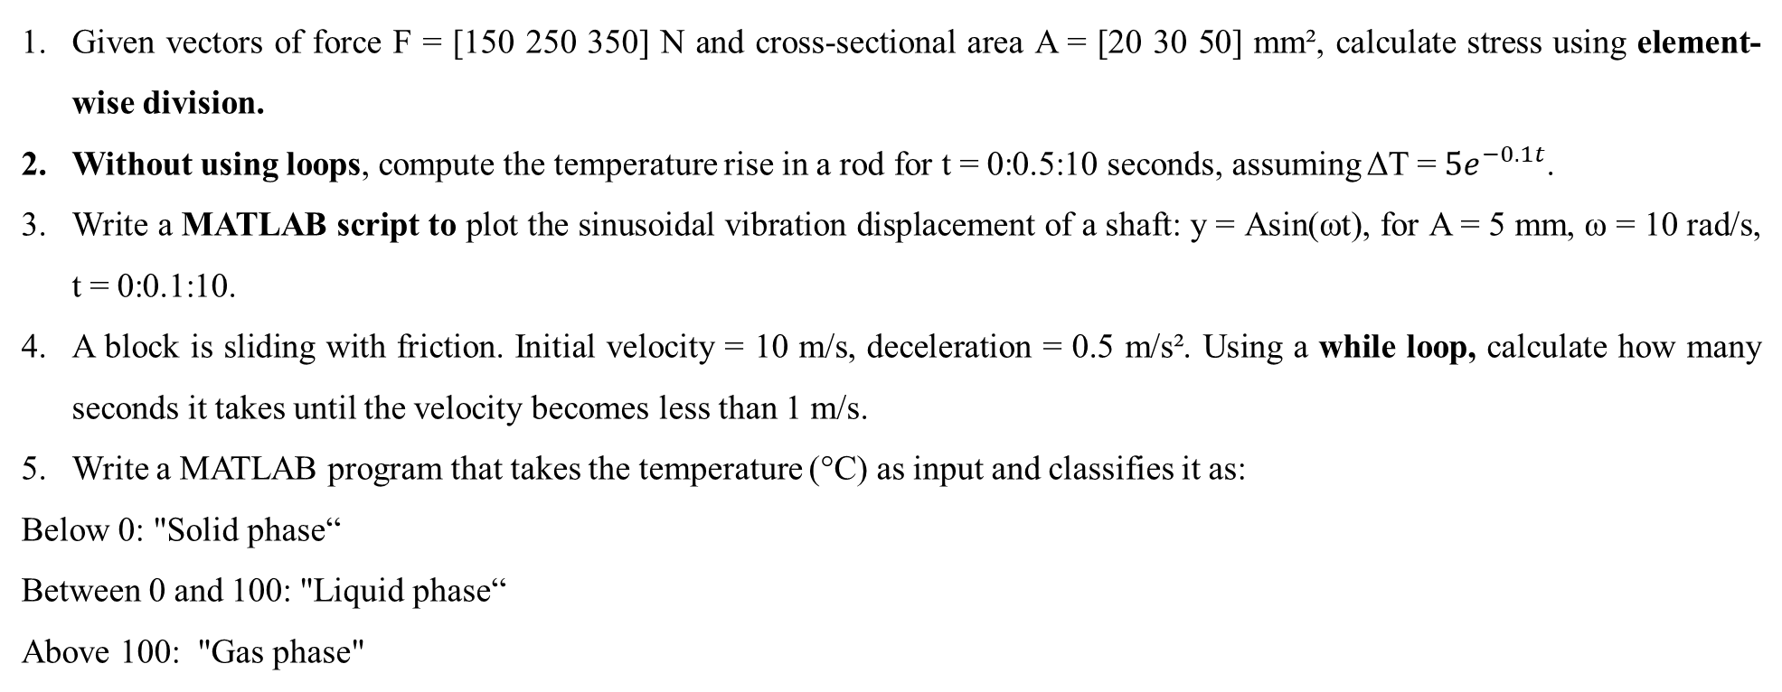
Practice questions
Given vectors of force F = [150 250 350] N and cross-sectional area A = [20 30 50] mm², calculate stress using element-wise division.
Without using loops, compute the temperature rise in a rod for t = 0:0.5:10 seconds, assuming ΔT = $5e^{−0.1t}$.
Write a MATLAB script to plot the sinusoidal vibration displacement of a shaft: y = Asin(ωt), for A = 5 mm, ω = 10 rad/s, t = 0:0.1:10.
A block is sliding with friction. Initial velocity = 10 m/s, deceleration = 0.5 m/s². Using a while loop, calculate how many seconds it takes until the velocity becomes less than 1 m/s.
Write a MATLAB program that takes the temperature (°C) as input and classifies it as:
Below 0: "Solid phase“
Between 0 and 100: "Liquid phase“
Above 100: "Gas phase"

Slide 15
Interactive input
Interactive input means allowing the user to enter values or data while the program is running. In MATLAB, this is usually done using the input function. The commands input, keyboard, menu, and pause can be used inside a script or function file for interactive user input.
It is used to make programs flexible (the user doesn’t need to edit code). Also, it is used to accept different parameters (length, load, angle, material properties, etc.) at runtime, and to make scripts interactive, like a simple calculator or solver.
% General Example:
variable = input('Prompt message: ');
Applications in Mechanical Engineering
Entering material properties (E, density, thermal conductivity).
Entering geometry values (length, diameter, area).
Entering boundary conditions in simulations.
Running design calculations interactively without changing the script.

Slide 16
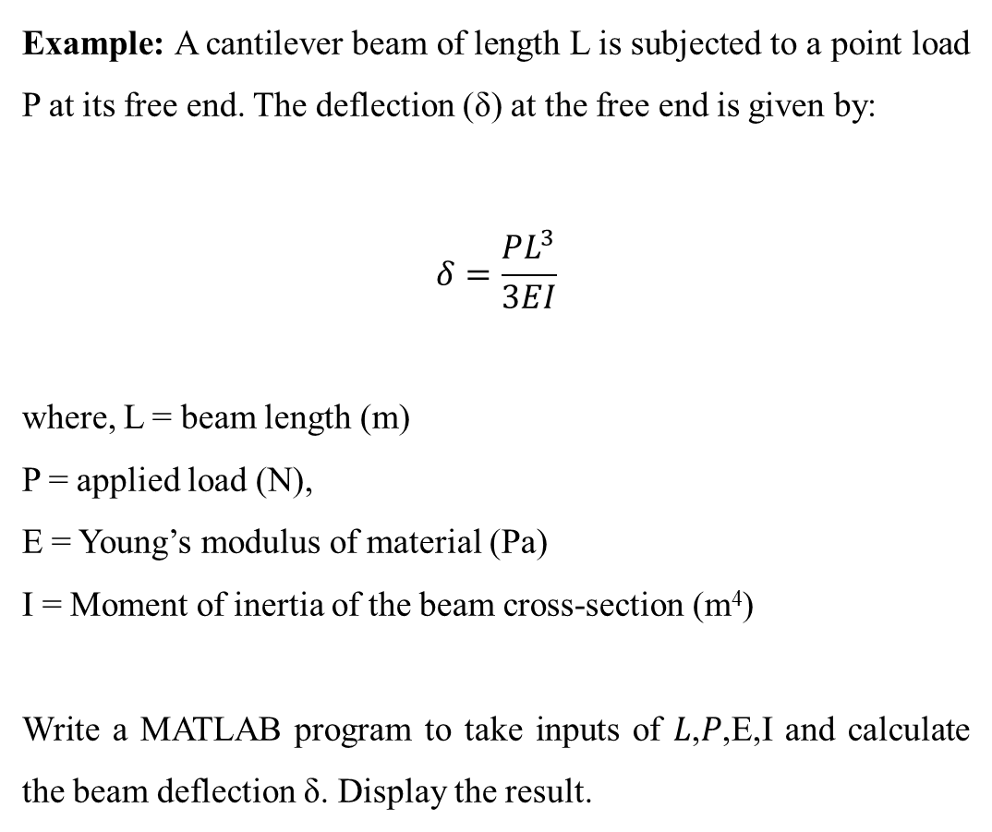
Example: A cantilever beam of length L is subjected to a point load P at its free end. The deflection (δ) at the free end is given by:
$$δ=\frac{PL^{3}}{3EI}$$
where, L = beam length (m)
P = applied load (N),
E = Young’s modulus of material (Pa)
I = Moment of inertia of the beam cross-section (m⁴)
Write a MATLAB program to take inputs of 𝐿,𝑃,E,I and calculate the beam deflection δ. Display the result.
Solution:
L = input('Enter beam length (m): ');
P = input('Enter applied load (N): ');
E = input('Enter Youngs modulus (Pa): ');
I = input('Enter moment of inertia (m^4): ');
delta = (P*L^3) / (3*E*I); % cantilever beam deflection
disp(['Beam Deflection = ', num2str(delta), ' m']);

Slide 17
2. Keyboard
Temporarily stops program execution and gives control to the command window. The user can check variables or commands. Execution continues with the return command.
Example: Write a MATLAB program that:
Defines two variables 𝑥=10 and 𝑦=20.
Pauses execution using the keyboard command for debugging.
After continuing execution calculates 𝑧=𝑥+𝑦
Displays the result.
x = 10;
y = 20;
keyboard; % program pauses here for debugging
z = x + y;
disp(['Result = ', num2str(z)]);

Slide 18
3. Menu
Creates a graphical menu for user selection. Returns an index corresponding to the chosen option. The command menu creates an on-screen menu with the MenuName and lists the options in the menu. The user can select any of the options using the mouse or the keyboard, depending on the computer.
Example:
Write a MATLAB program that:
Displays a menu with three options: Steel, Aluminium, Copper.
Stores the user’s choice in the variable choice.
Uses if–elseif statements to display which material was selected.
choice = menu('Choose a material:','Steel','Aluminium','Copper’);
if choice == 1
disp('You selected Steel');
elseif choice == 2
disp('You selected Aluminium');
elseif choice == 3
disp('You selected Copper');
end

Slide 19
4. Pause
The command pause temporarily halts the current process. It can be used with or without an optional argument
Example:
Write a MATLAB program using a for loop that:
Prints the message “Step 1”, “Step 2”, … up to “Step 5”.
Waits for 1 second between each step using the pause function.
for i = 1:5
disp(['Step ', num2str(i)]);
pause(1); % wait for 1 second before next iteration
end

Slide 20
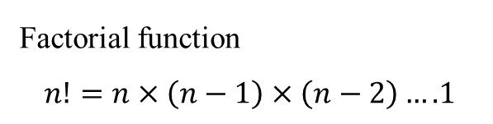
Recursion
The MATLAB programming language supports recursion, i.e., a function can call itself during its execution. Thus, recursive algorithms can be directly implemented in MATLAB.
Example of Recursion in MATLAB
Factorial function
$$n!=n×\left(n−1\right)×\left(n−2\right)….1$$
function f = factorialRec(n)
if n == 0 || n == 1
f = 1; % base case
else
f = n * factorialRec(n-1); % recursive case
end
end

Slide 21
Example: Fibonacci Sequence
𝐹(𝑛)=𝐹(𝑛−1)+𝐹(𝑛−2), 𝐹(0)=0, 𝐹(1)=1
The Fibonacci sequence is a series of numbers where each number is the sum of the two preceding numbers, starting with 0 and 1. The sequence begins as 0, 1, 1, 2, 3, 5, 8, 13, and continues infinitely.
function Fn = fibonacciRec(n)
if n == 0
Fn = 0; % base case
elseif n == 1
Fn = 1; % base case
else
Fn = fibonacciRec(n-1) + fibonacciRec(n-2); % recursive case
end
end

Slide 22
Practice questions
A beam is subjected to point loads at different positions. The load vector is: P (N) = [100 200 150 250]; The deflection factor is: δ (N/mm) = [0.5 0.4 0.6 0.3]; Write a MATLAB program to calculate the element-wise multiplication to find actual deflections.
Write a vectorized MATLAB program to calculate the strain values for 50 points, where strain = stress/E, stress varies from 0 to 250 MPa, and E = 200 GPa.
Use MATLAB’s max, min, and mean functions to analyze a vector of stress values: [120 150 180 200 160]. Display maximum, minimum, and average stress.
Write a MATLAB script that calculates torque = Force × Distance. Insert a keyboard command to pause execution so the user can check variables before continuing.
Write a MATLAB script to input length, breadth, height of a cuboid and calculate its volume.
Write a function to calculate power = Force × Velocity. If Velocity = 0, exit the function using return and display a warning message.

Slide 23
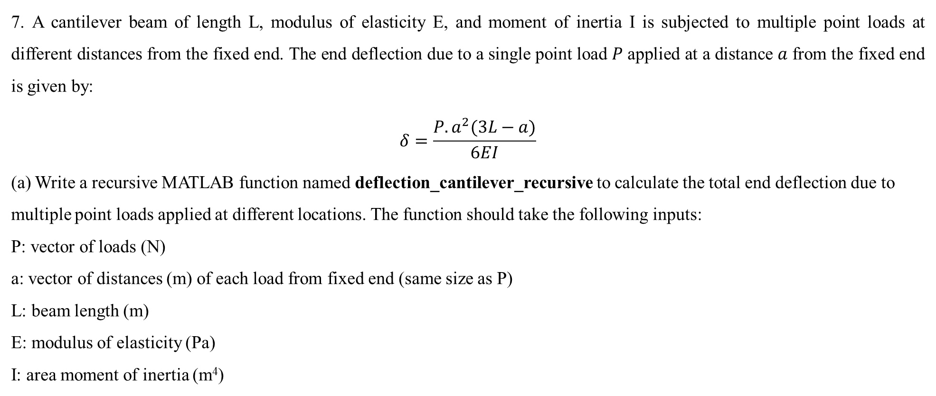
7. A cantilever beam of length L, modulus of elasticity E, and moment of inertia I is subjected to multiple point loads at different distances from the fixed end. The end deflection due to a single point load 𝑃 applied at a distance 𝑎 from the fixed end is given by:
$$δ=\frac{P.a^{2}(3L−a)}{6EI}$$
(a) Write a recursive MATLAB function named deflection_cantilever_recursive to calculate the total end deflection due to multiple point loads applied at different locations. The function should take the following inputs:
P: vector of loads (N)
a: vector of distances (m) of each load from fixed end (same size as P)
L: beam length (m)
E: modulus of elasticity (Pa)
I: area moment of inertia (m⁴)
(b) Using your function, compute the total deflection for a cantilever beam with:𝐿=2 m, 𝐸=2×10¹¹ Pa, 𝐼=1×10⁻⁶ m⁴, loads 𝑃=[100, 150, 250] N, and applied at distances 𝑎=[0.4, 1.2, 1.6] m. Write the MATLAB code for the function and show the output.

